Slide 1

PERFORMANCE EVALUATING SYSTEM
TRANS-MERCH APPAREL (PVT) LTD
A.M.M.M.ABEYSINGHE
142033

Slide 2
CONTENT
Introduction
GUI Designing
Database Designing
Report Designing

Slide 3
INTRODUCTION
Name : Trans-Merch Apparel Pvt Ltd
established in Toronto, Canada in 2006
Sri Lankan branch
Located in Mahara,Kadawatha
Established in 2015.07.02.
Current owner - Mr. Welayudan Ilangeshwaran
Number of workers - 126 under 3 managerial levels

Slide 4
GUI DESIGNING

Slide 5
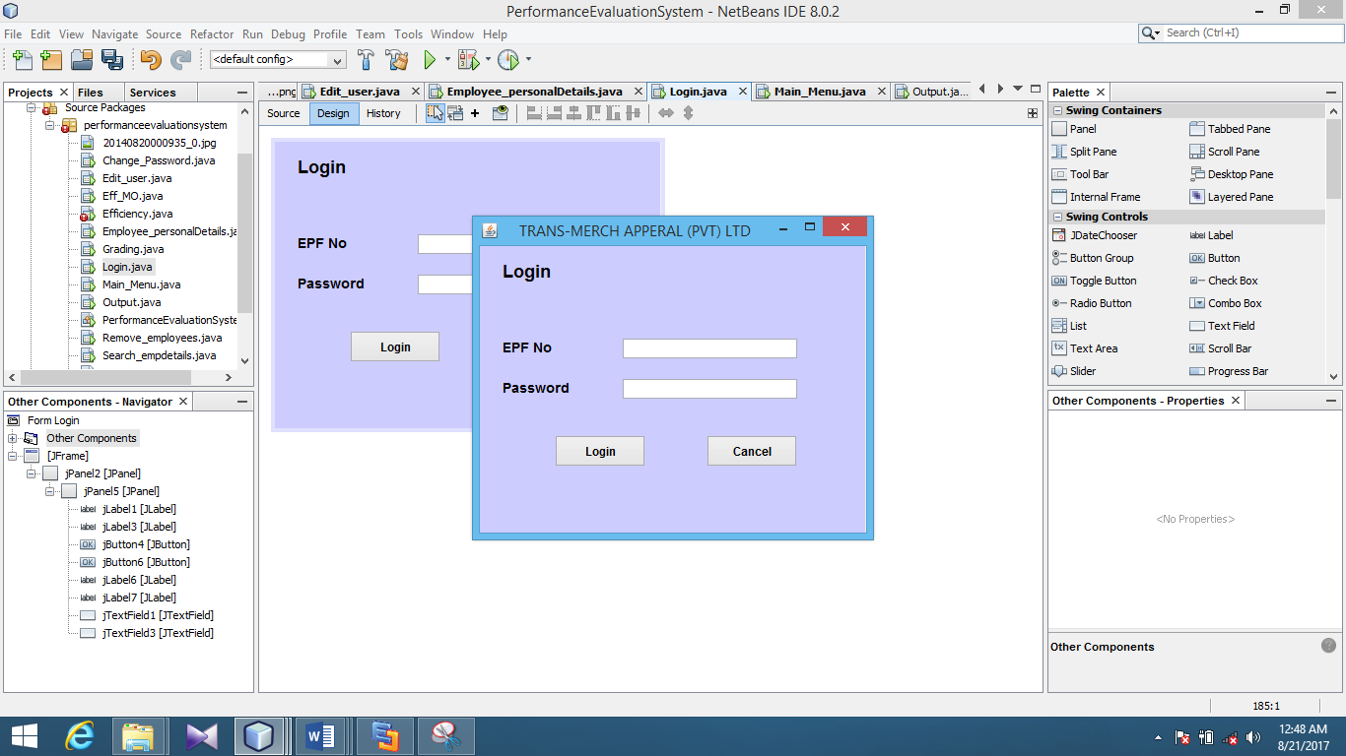
Login

Slide 6
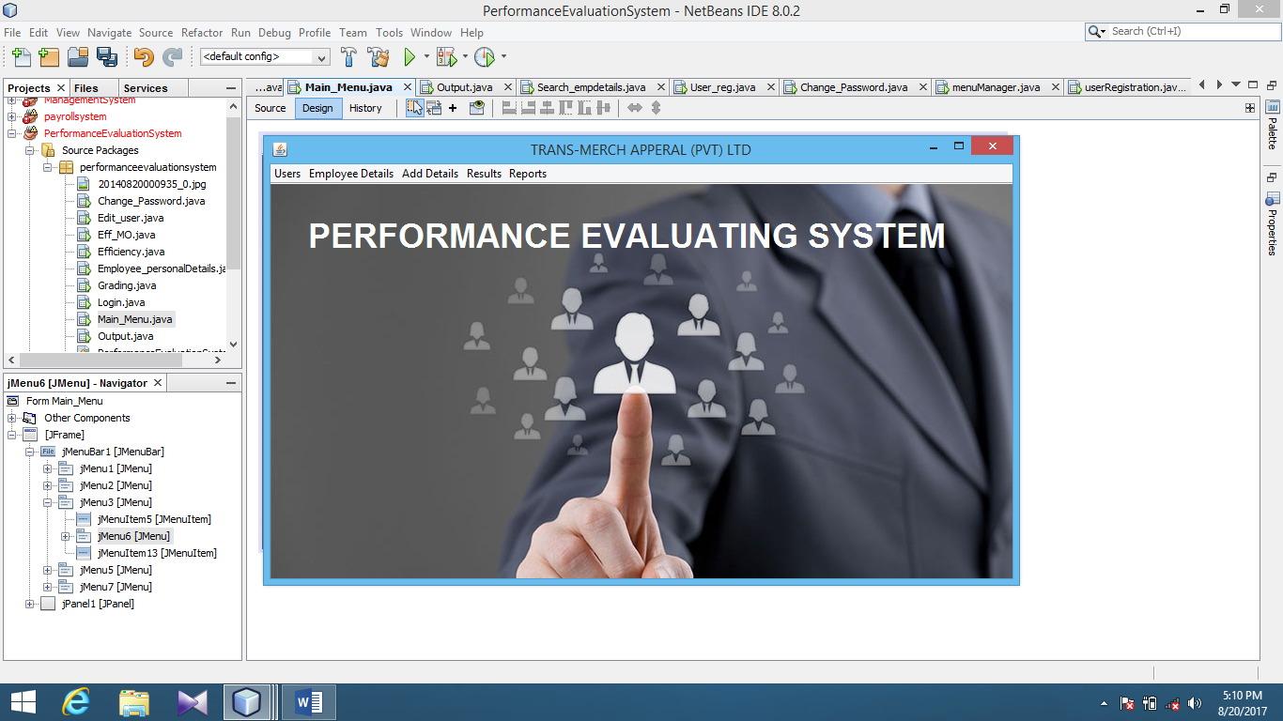
Main Menu

Slide 7
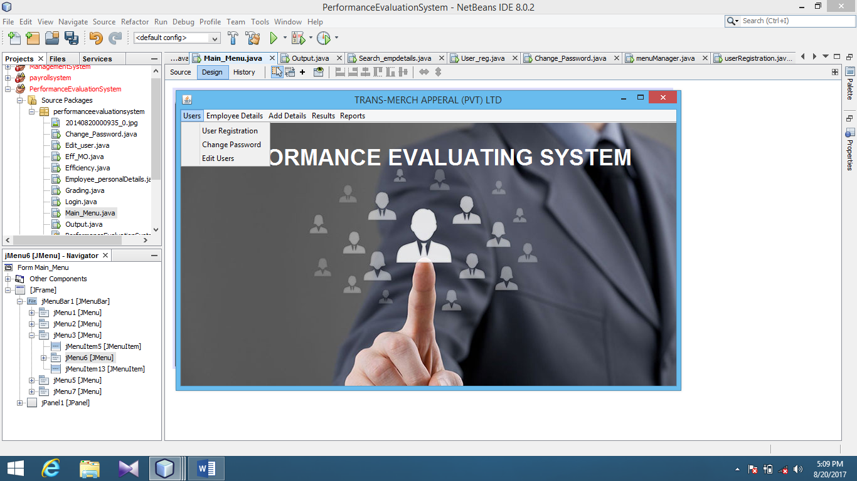
Users Menu

Slide 8
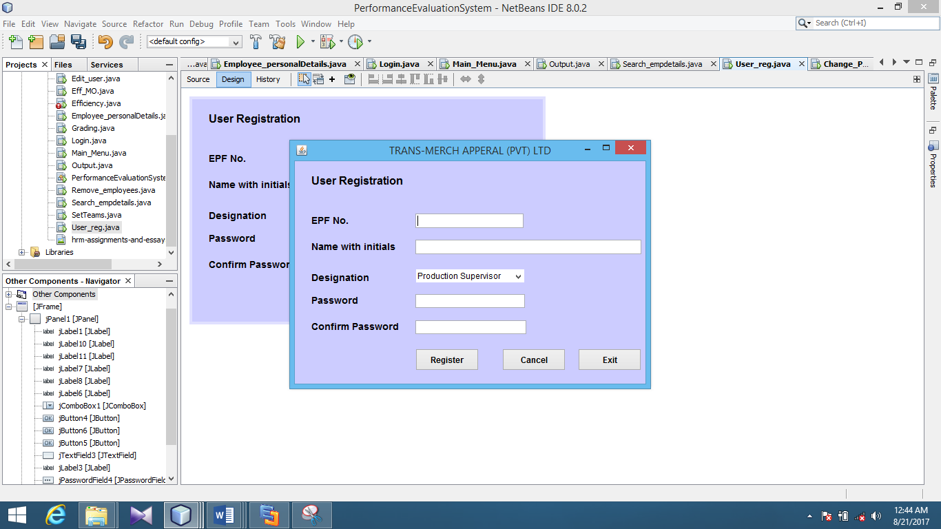
User Registration

Slide 9
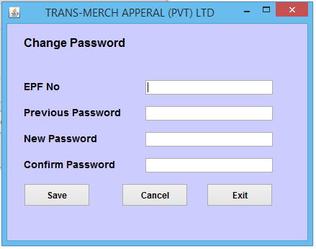
Change Password

Slide 10
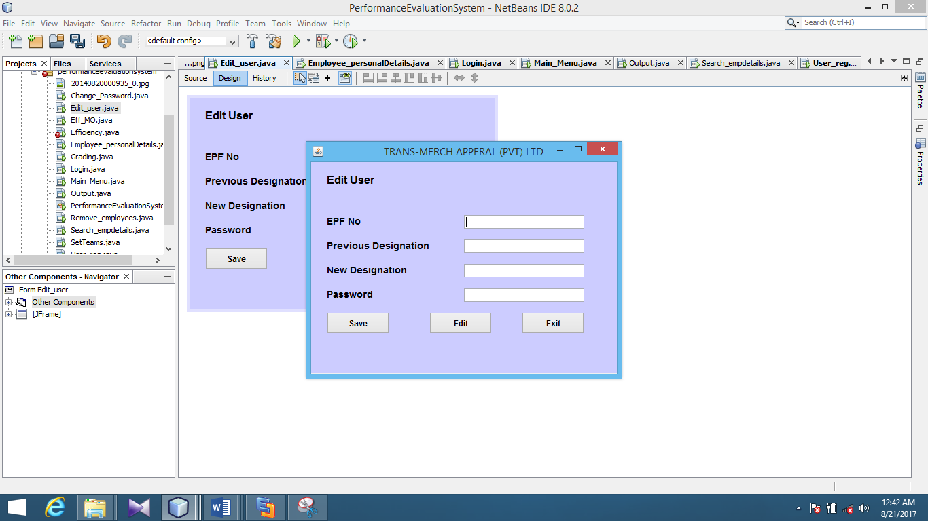
Edit User

Slide 11
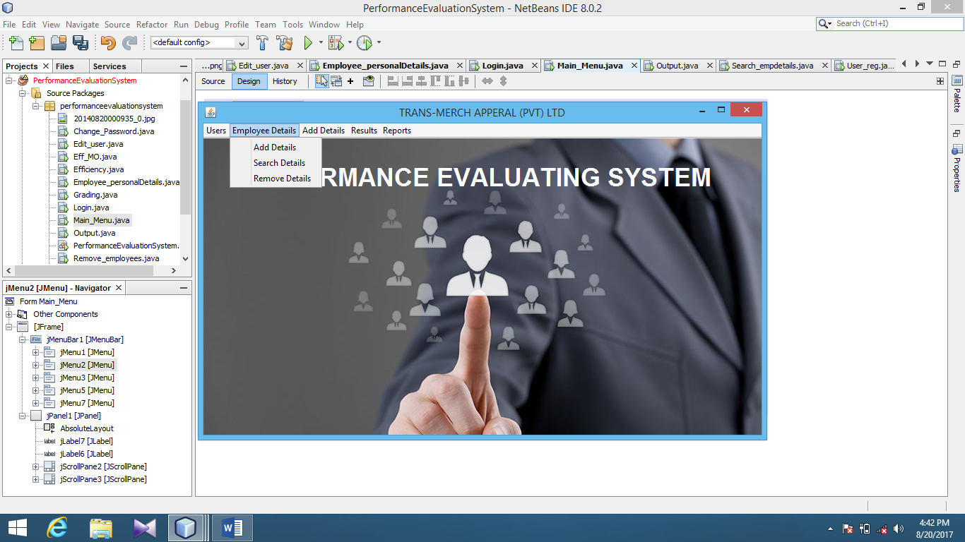
Employee Details Menu

Slide 12
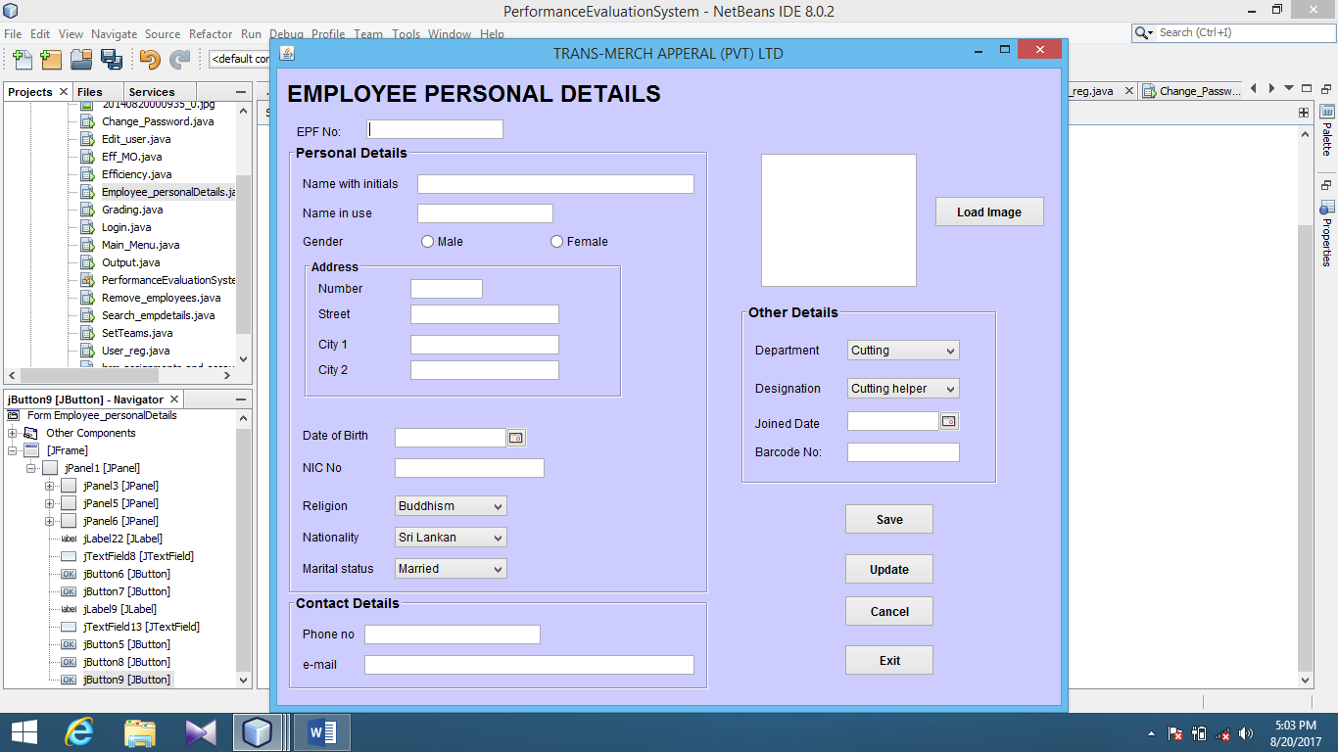
Employee Personal Details

Slide 13
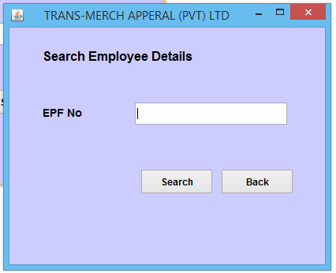
Search Employee Details

Slide 14
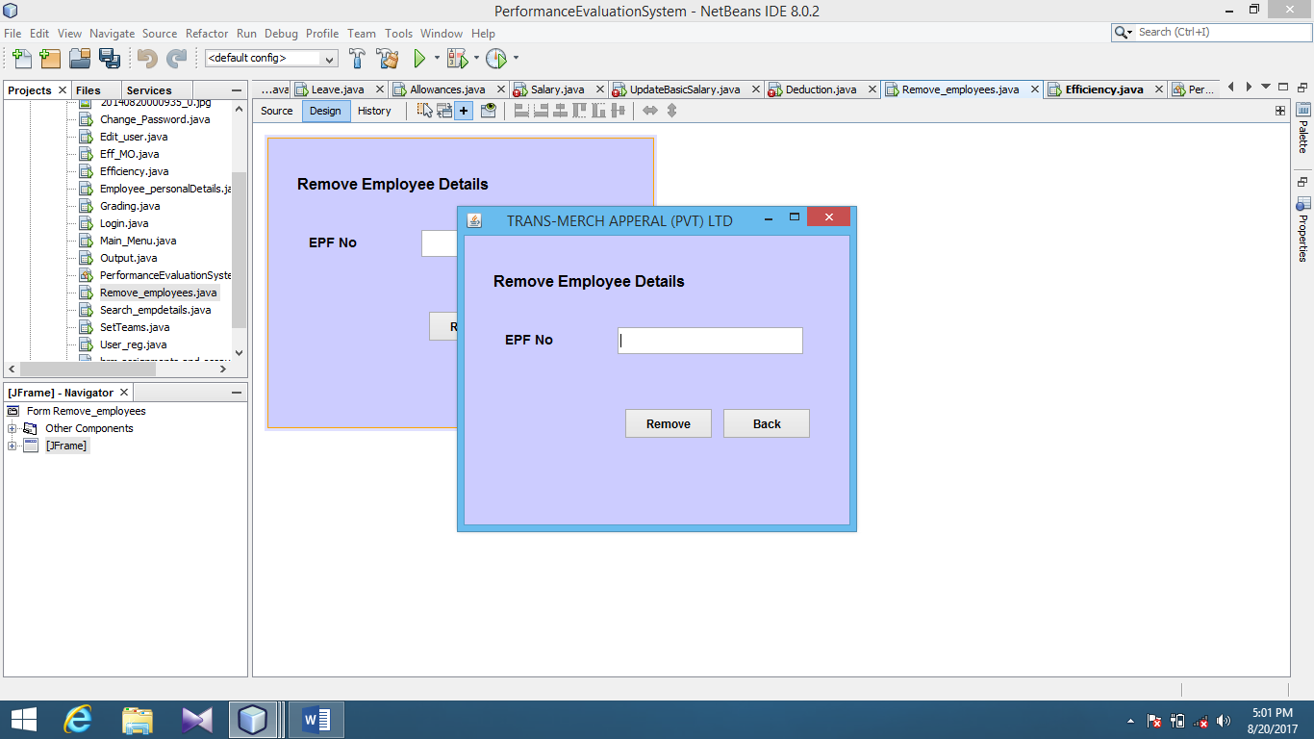
Remove Employee Details

Slide 15
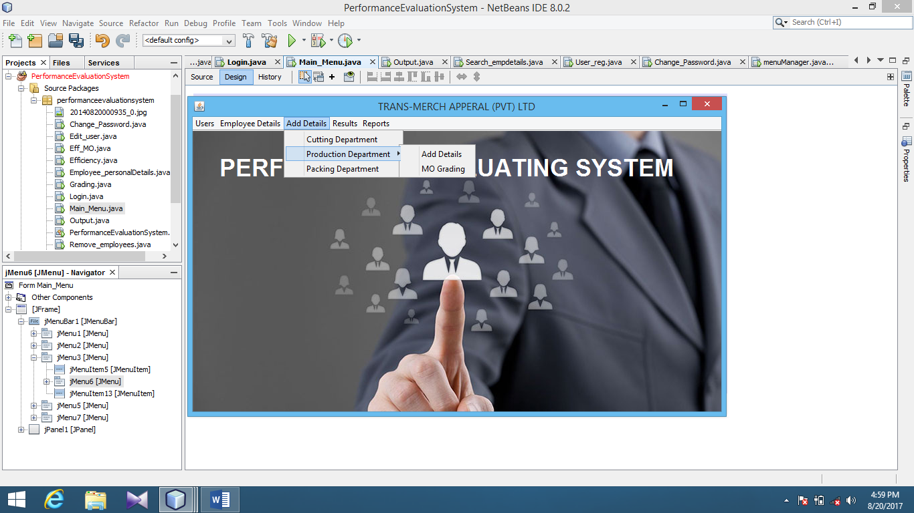
Add Details Menu

Slide 16
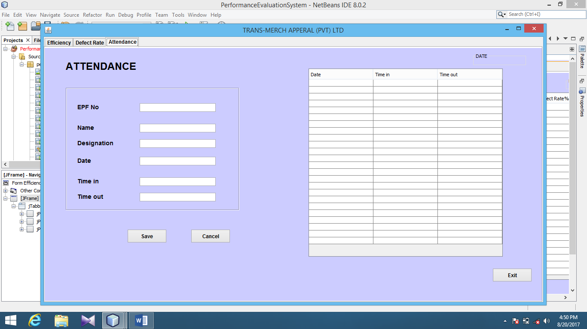
Attendance

Slide 17
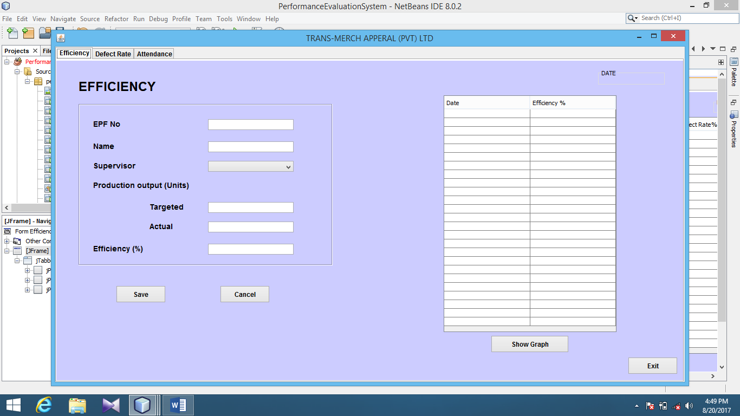
Efficiency – Other Employees

Slide 18
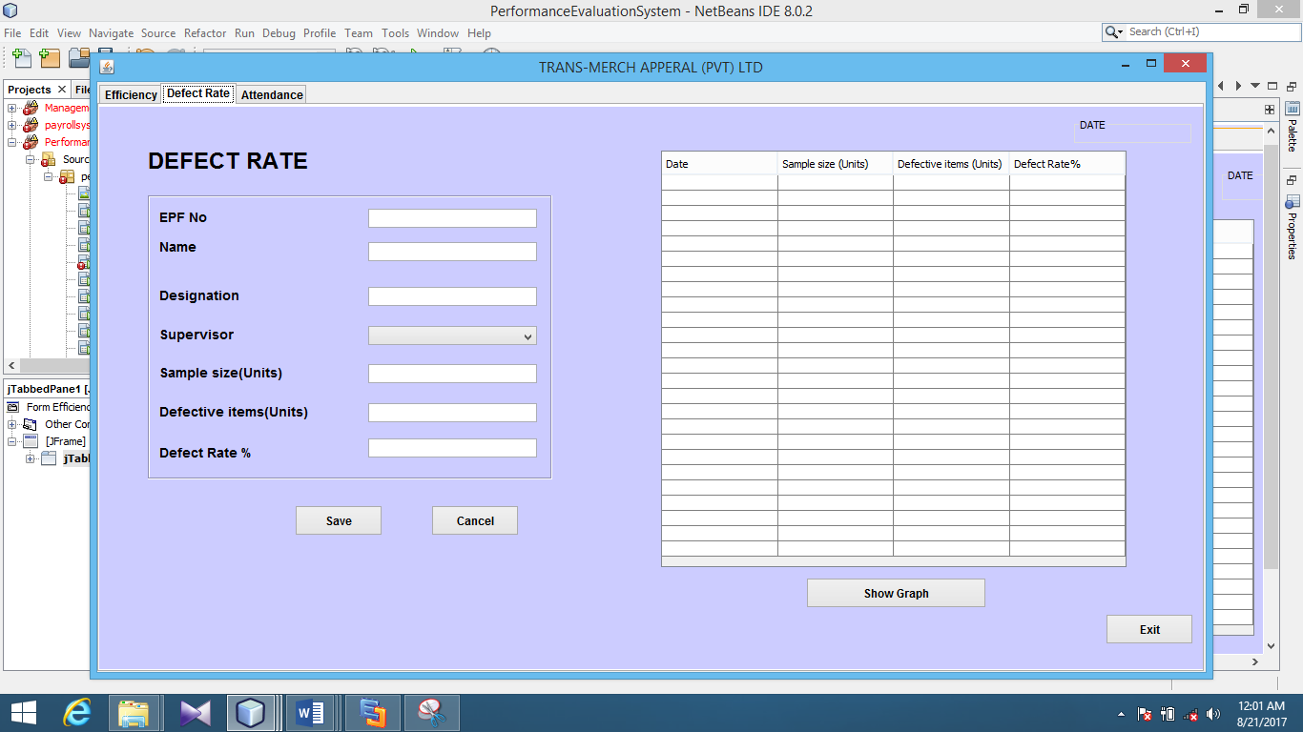
Defect Rate – Other Employees

Slide 19
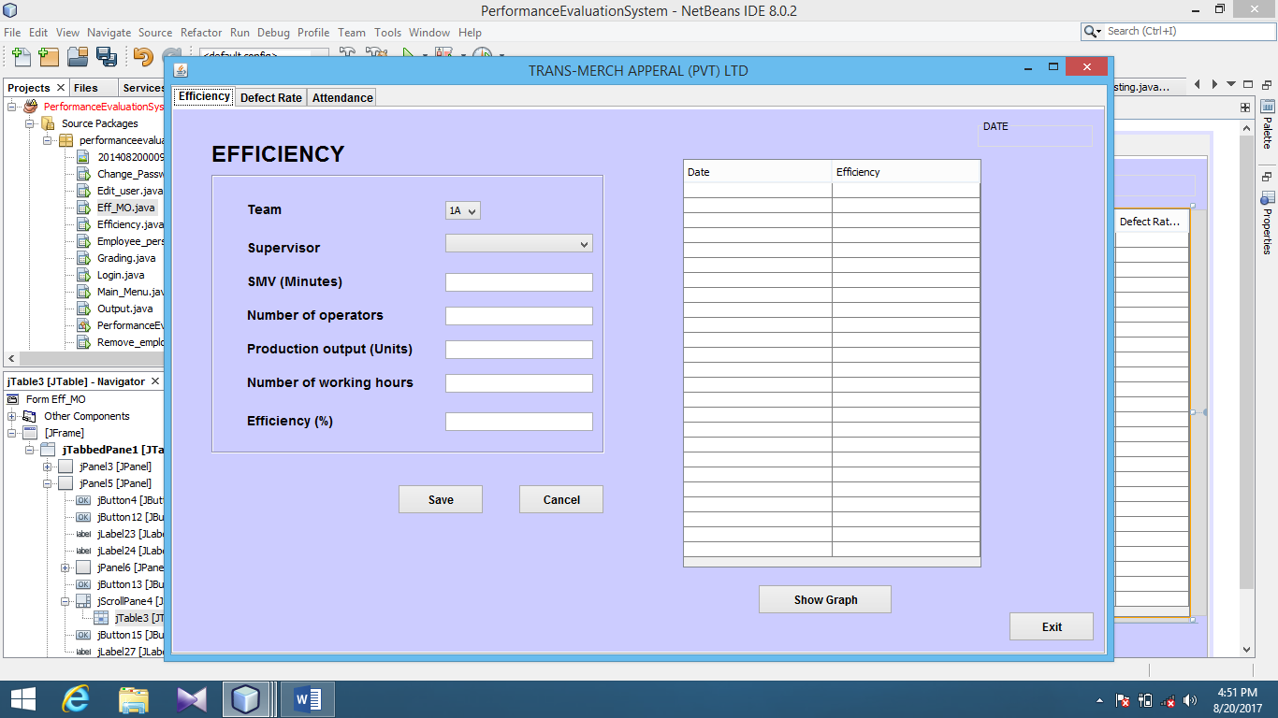
Efficiency – Machine Operator and Helper

Slide 20
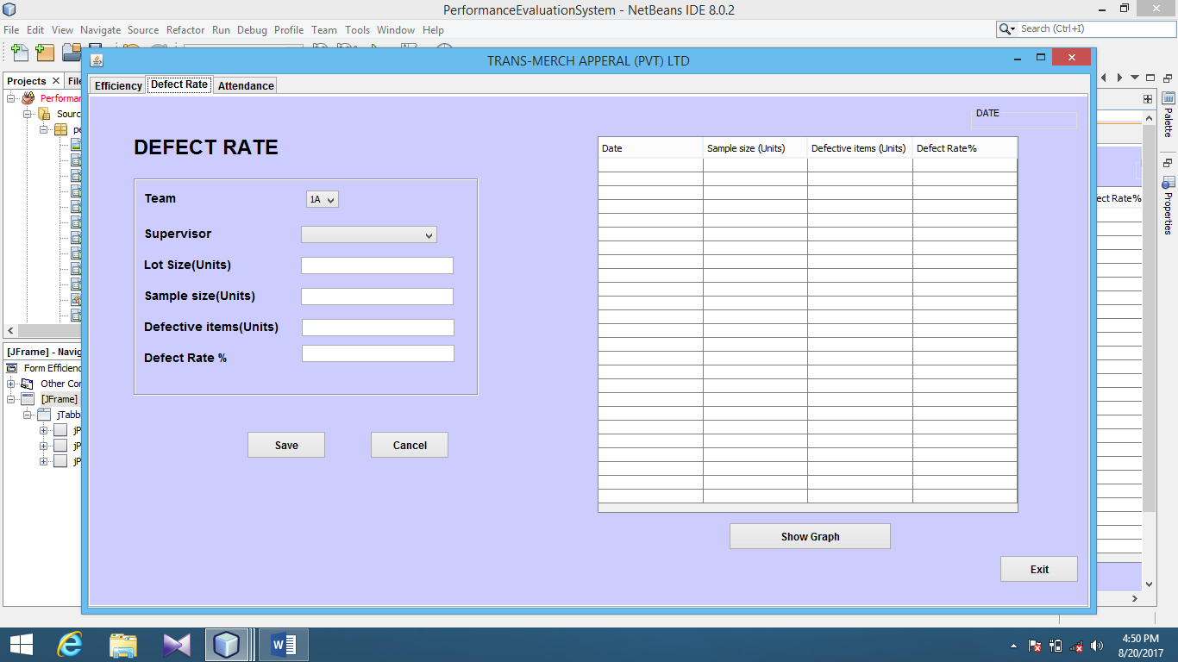
Defect Rate – Machine Operator and Helper

Slide 21
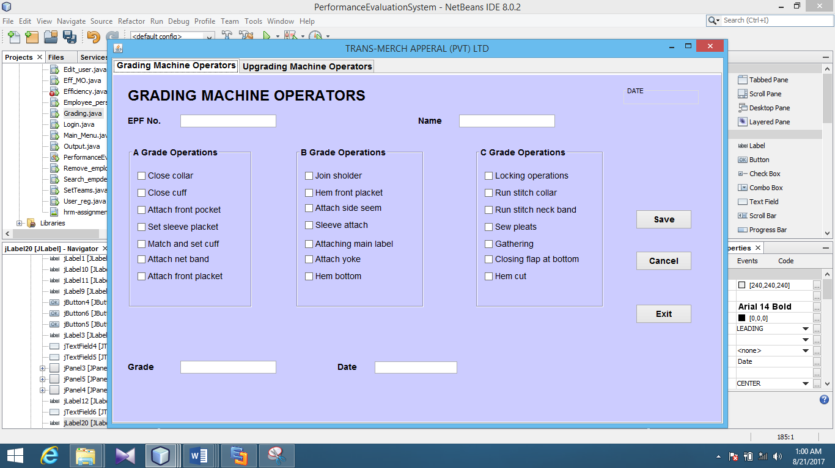
Grading Machine Operators

Slide 22
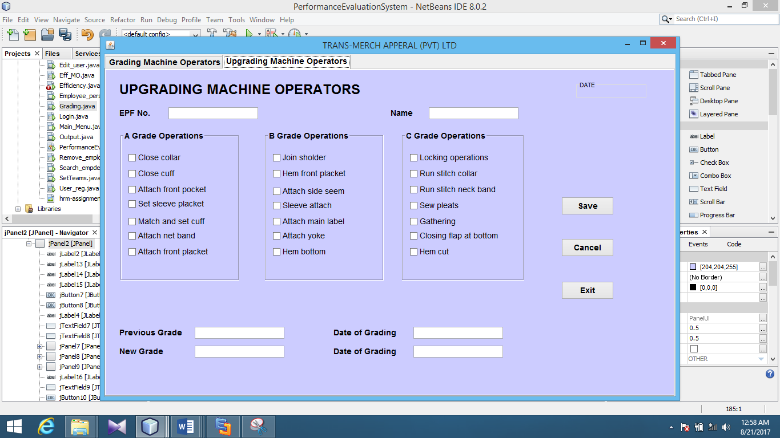
Upgrading Machine Operators

Slide 23
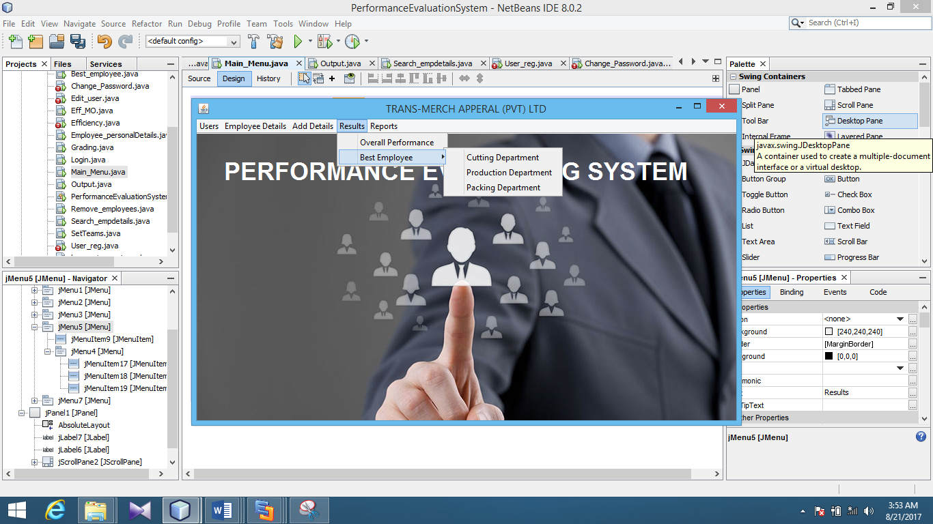
Results

Slide 24
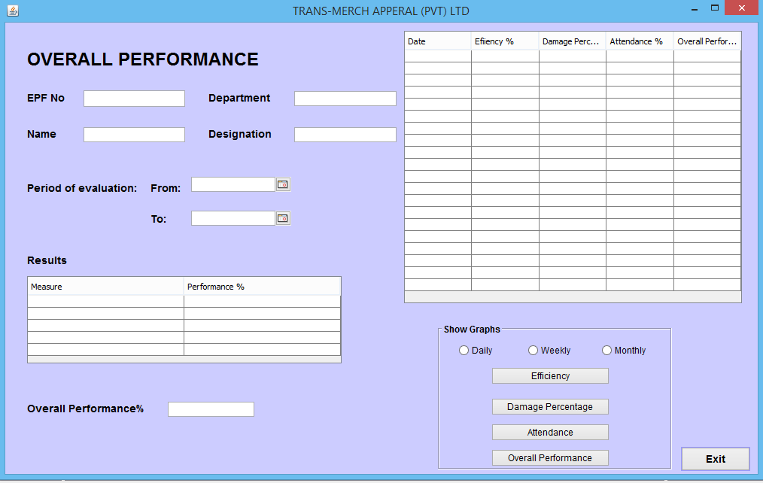
Overall Performance

Slide 25
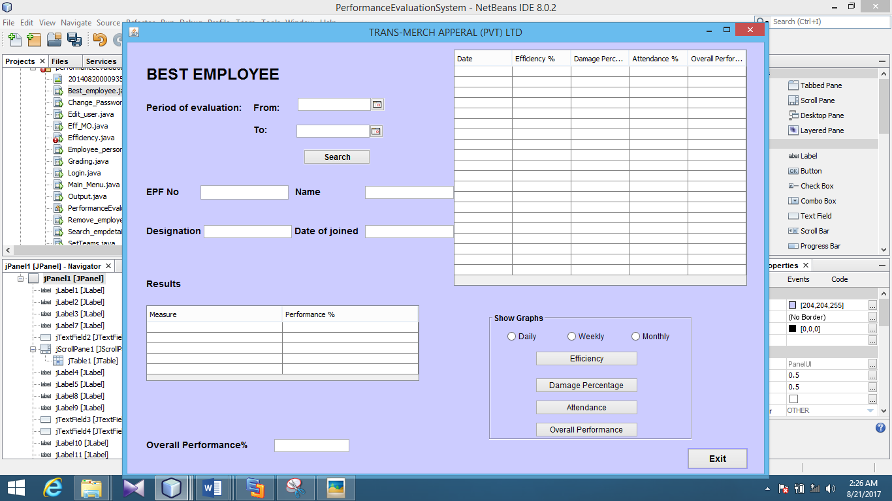
Best Employee

Slide 26
DATABASE DESIGNING

Slide 27
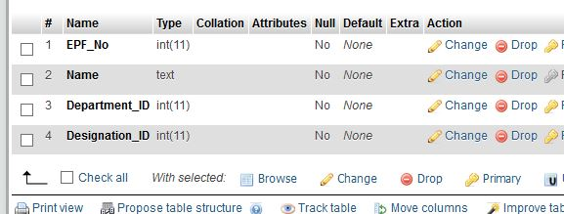
User Table

Slide 28
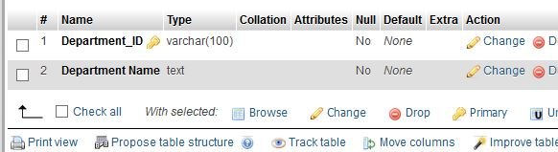
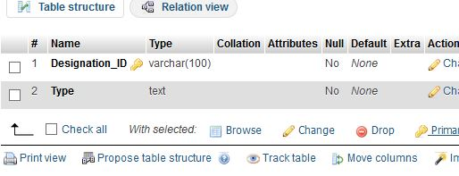
Department Table
Designation Table

Slide 29
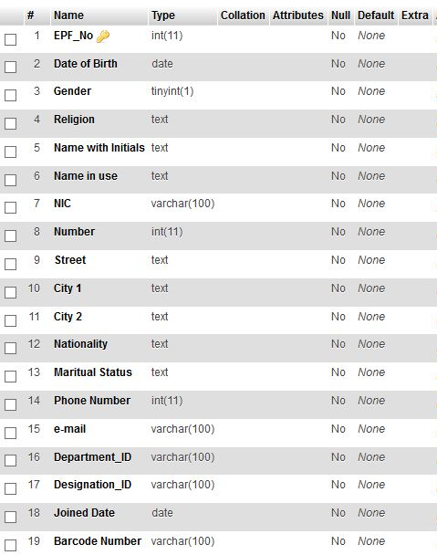
Overall
Performance

Slide 30
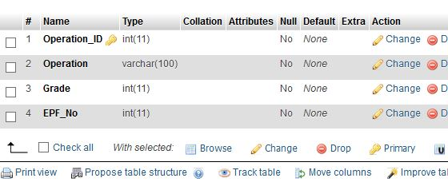
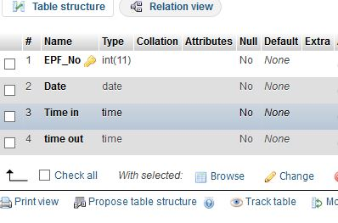
Operation Table
Attendance Table

Slide 31
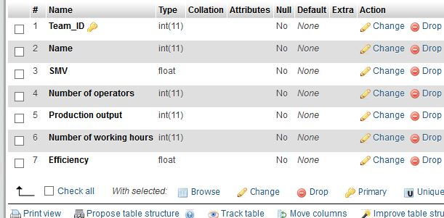
Machine Operator Efficiency Table

Slide 32
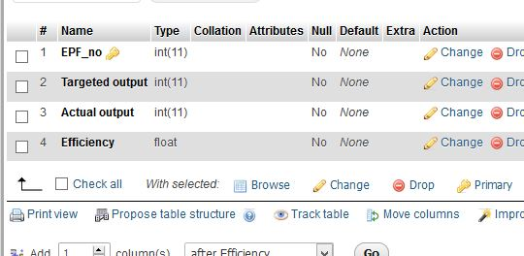
Other Employee Efficiency Table

Slide 33
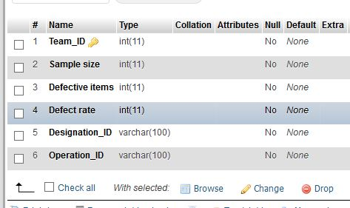
Machine Operator Defect Rate Table

Slide 34
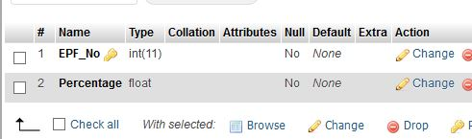
Performance Table

Slide 35
REPORT DESIGNING

Slide 36
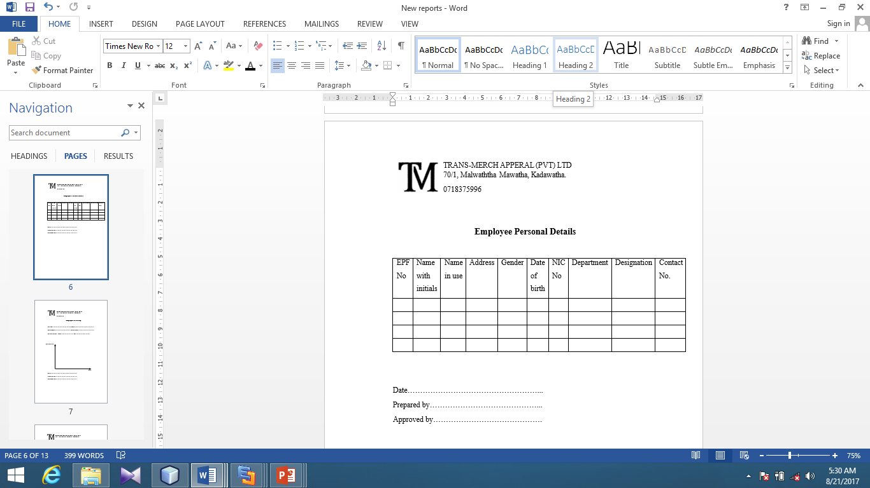
Employee Personal Details

Slide 37
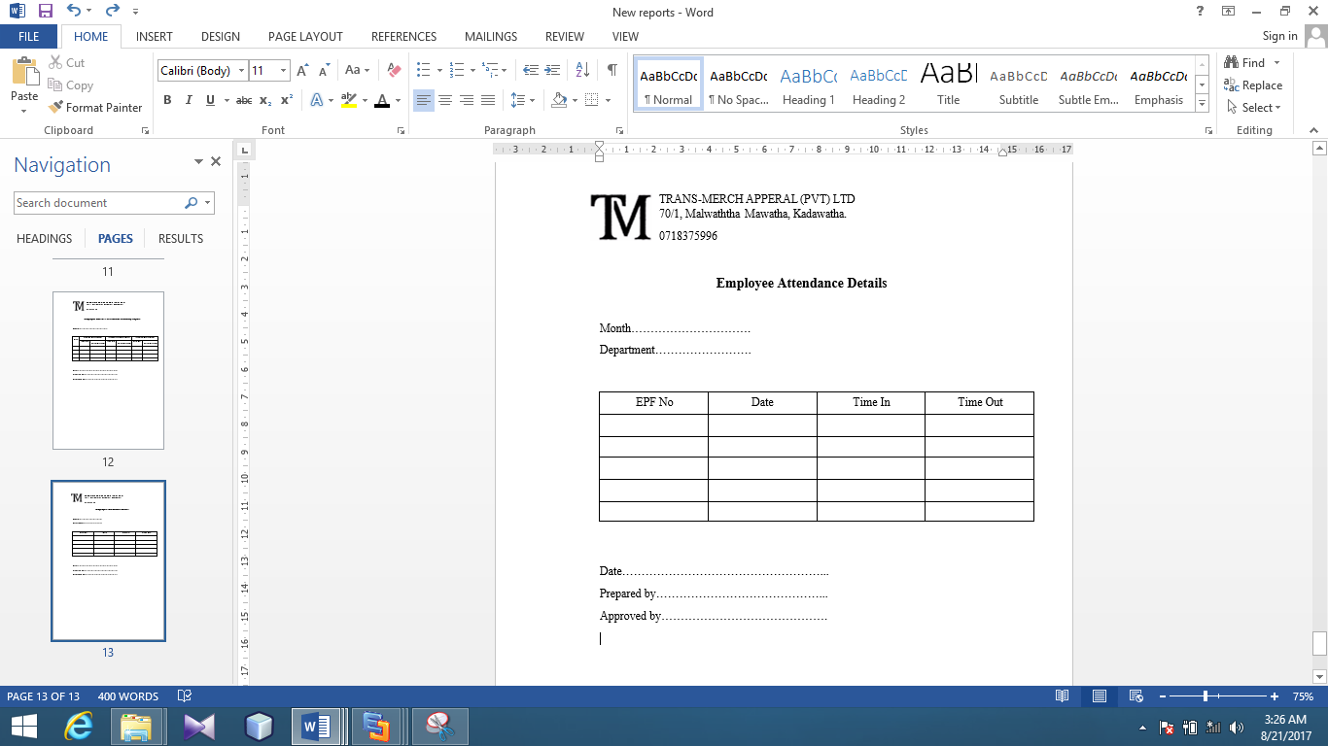
Attendance Details

Slide 38
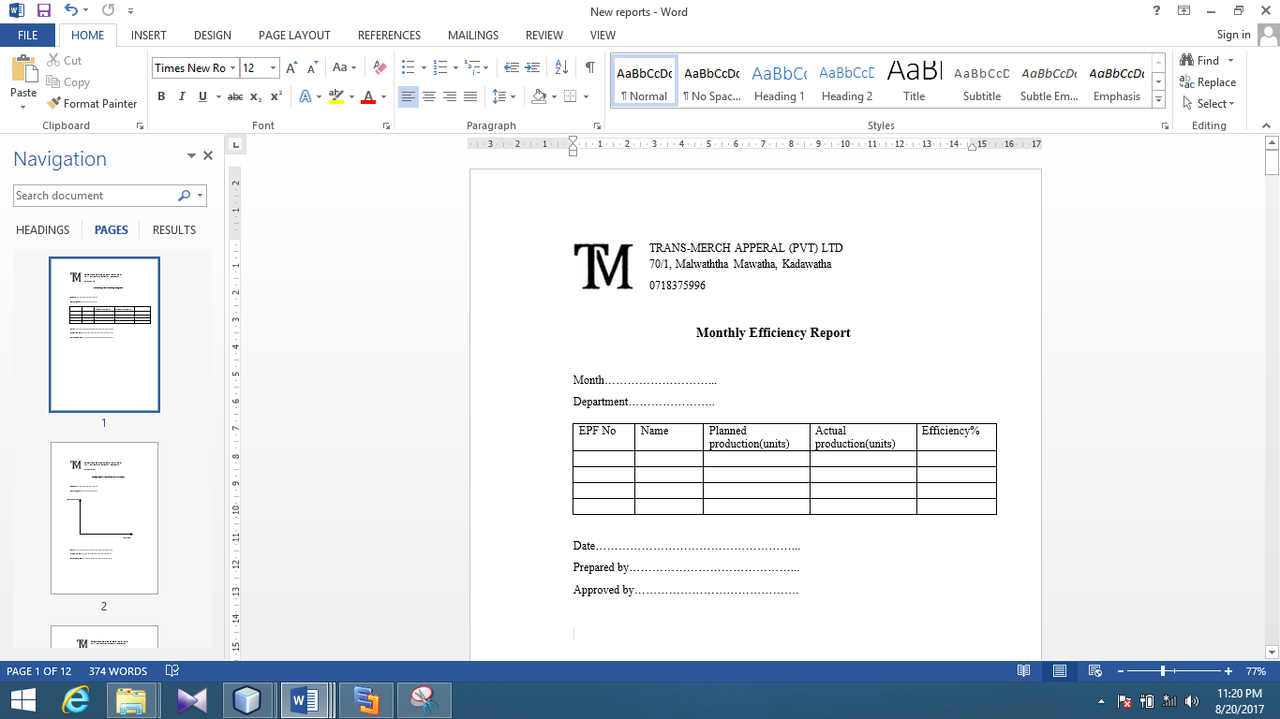
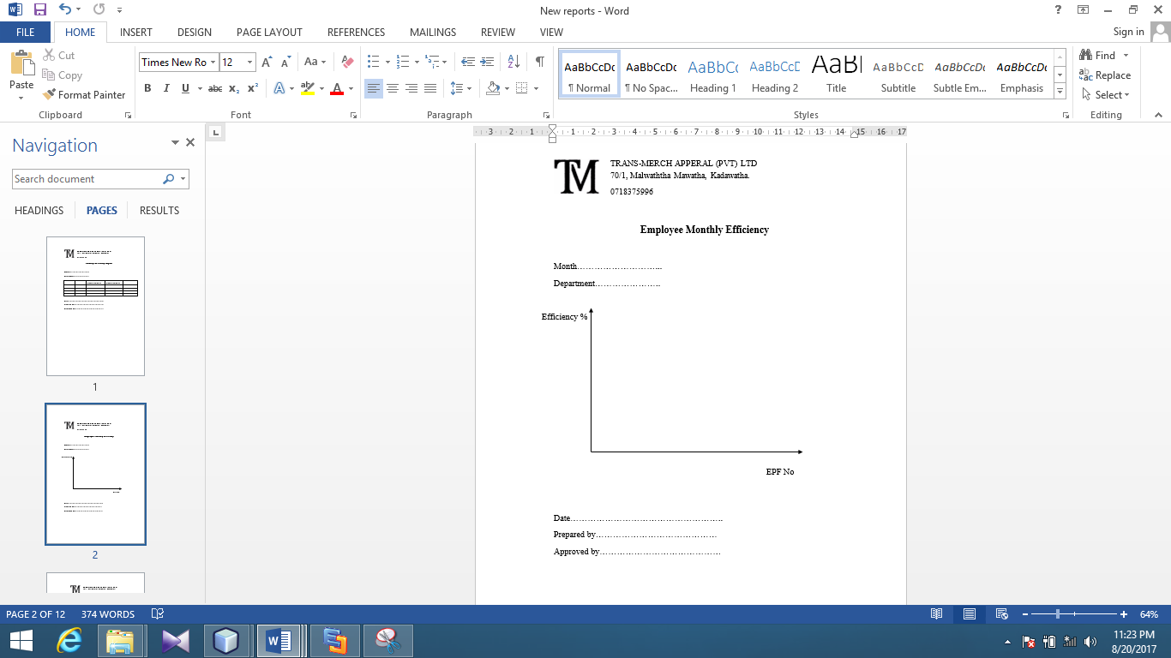
Monthly Efficiency Details

Slide 39
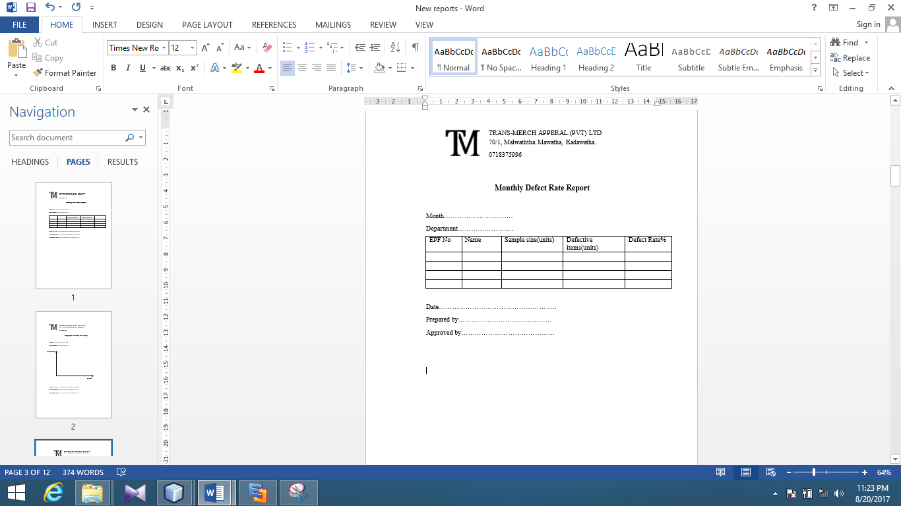
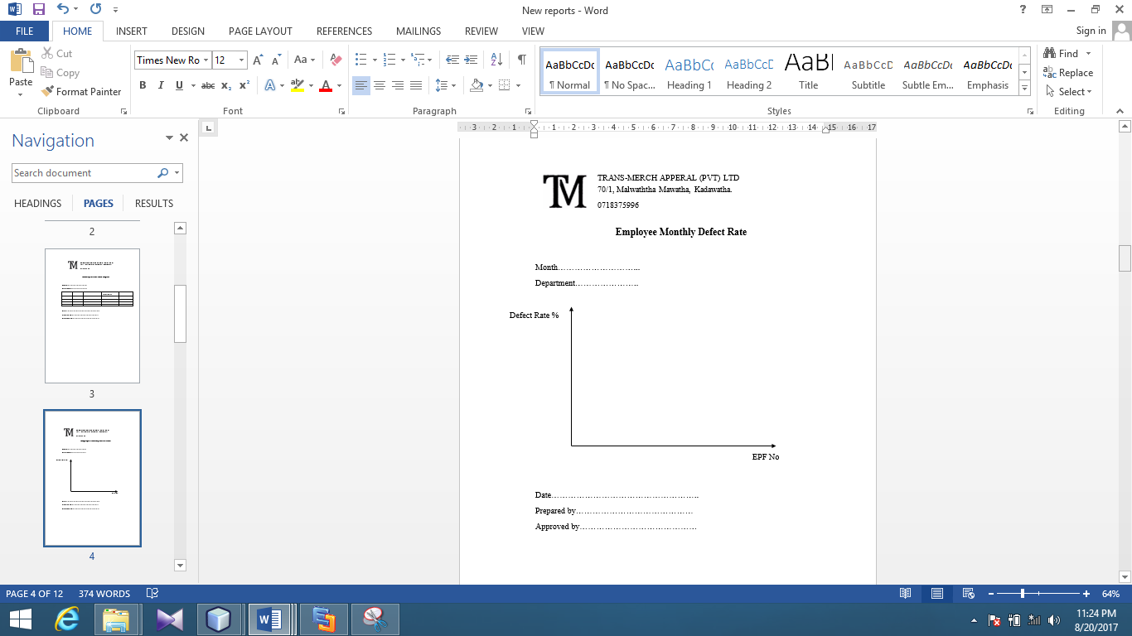
Monthly Defect Rate

Slide 40
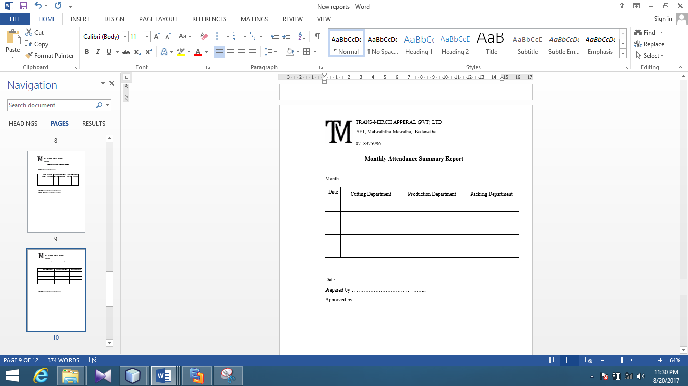
Attendance Summary Report

Slide 41
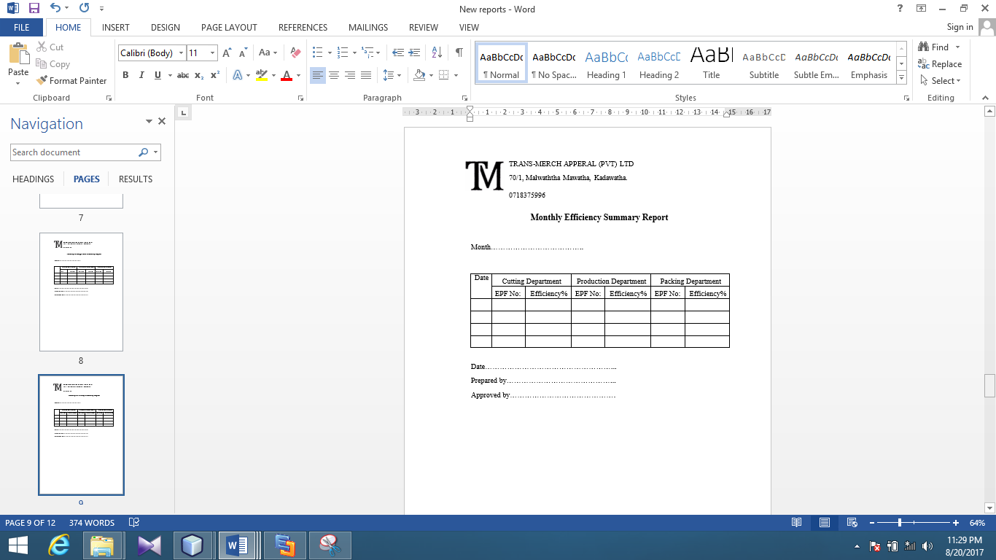
Efficiency Summary Report

Slide 42
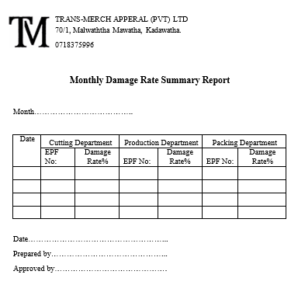
Damage Rate Summary Report

Slide 43
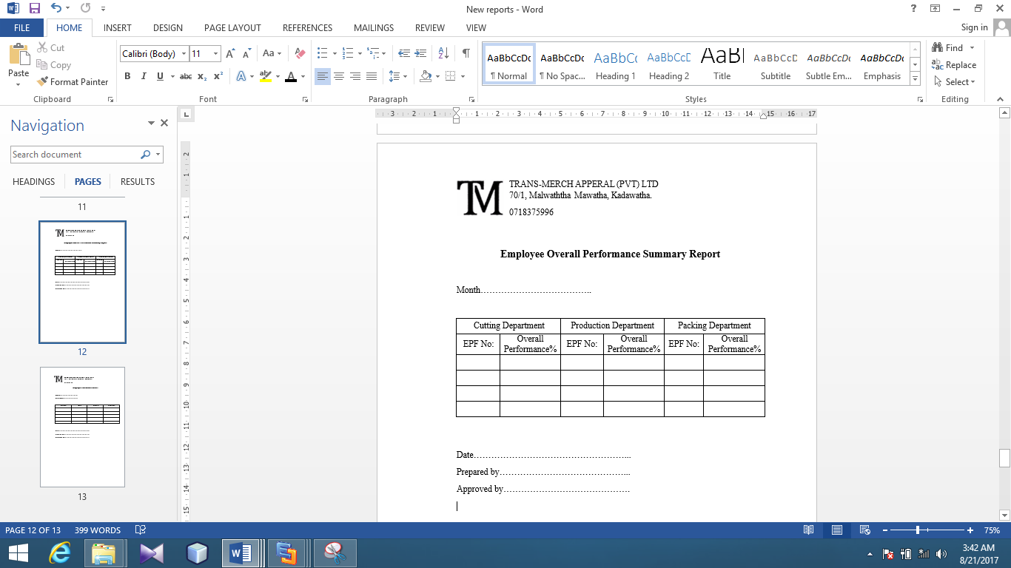
Overall Performance Summary Report (Department wise)

Slide 44
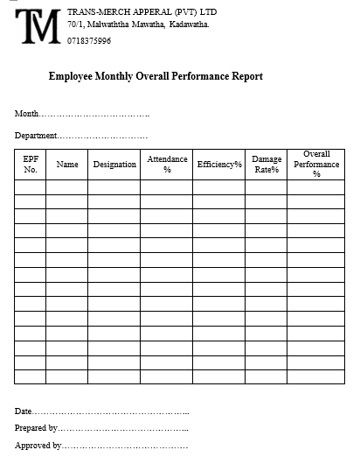
Employee Overall Performance Report

Slide 45
Q & A

Slide 46
THANK YOU

